Slide 1



Presented By
JOY PAL
ID: 201002418
Dept. of CSE
Green University

Slide 2

Issues of MACROECONOMICS

Slide 3
Table of contents
01
02
03
Major Issues in Macroeconomics
Marcroeconomics
Major Issues Details

Slide 4


What is Macroeconomics ?
A branch of economics that studies how an overall economy behaves.

Slide 5




Major Macroeconomic Issues
1. Economic Growth
2. Inflation
3. Unemployment

Slide 6
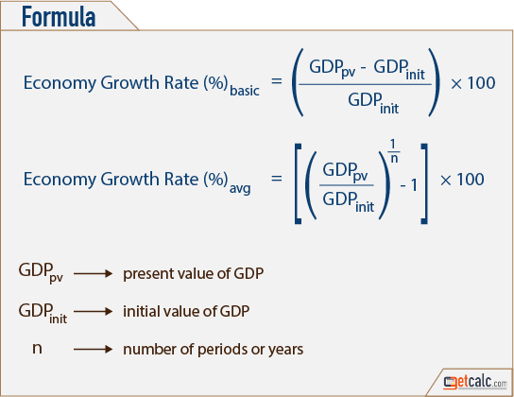
Economic Growth
Economic growth occurs when an economy is able to produce more goods and services
Growth Rate
The percentage change in output or national income

Slide 7
Inflation
Sustained increase in the general price level.
Purchasing power falls
Real wage rate = X 100
Nominal wage
Price Level
Fixed income earns loose their income
Inflation redistributes income
Borrowers gain from inflation

Slide 8
Unemployment
A person is
- Age group (16 to 65 years)
- Willingness to do the job & Full time employment
- Searching for suitable job at least for two months
Cost of Unemployment
1. Economic Costs
2.Human & Social Costs
Causes psychological and even physical disorders, divorces, suicides and crime
Economy is deprived from the possible production

Slide 9


Thank You!

